Slide 1
Presentation Of Python
By Navneet Kaur(500201277)

Slide 2
Libraries I have used two libraries: tkinter and sqlite3

Slide 3
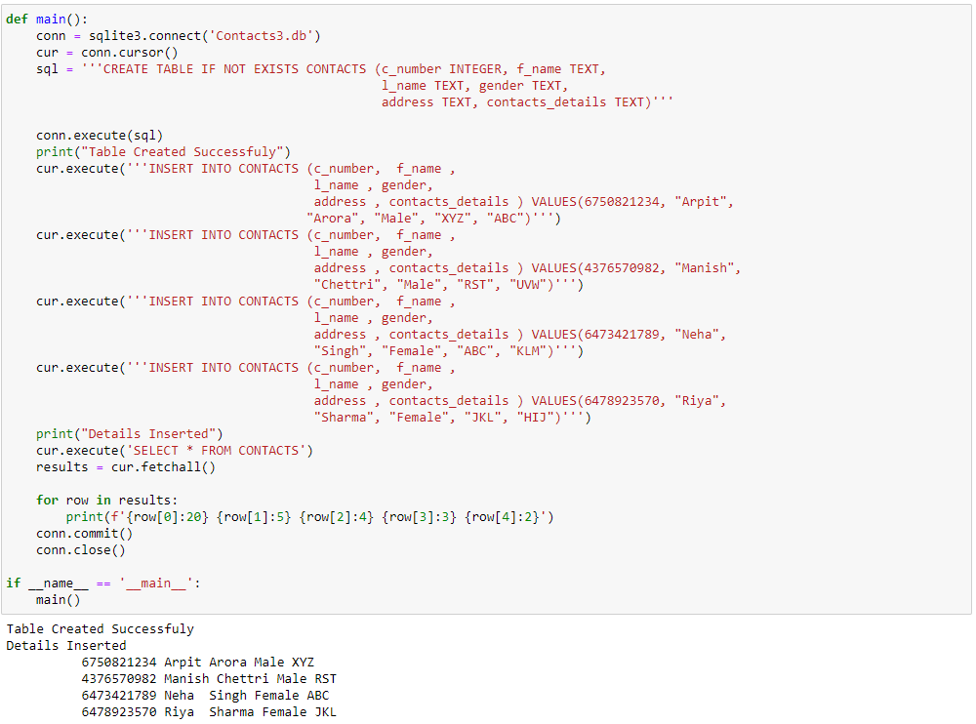
Using sqlite3 to make a table of contact list and executing these contacts in rows and columns

Slide 4
I used this command because my first contact was repeating and to remove that repetition, this command was entered.

Slide 5
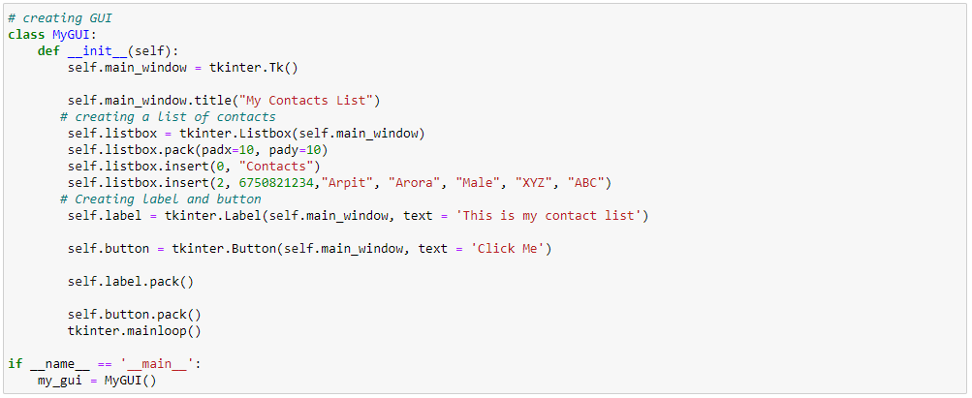
Then, tkinter is used to make a window in which my contact list is to be executed. In this, listbox is used to make a list in GUI

